Slide 1
Data types and structures in R
Elpida Vounzoulaki, BSc(Hons), MSc
Postdoctoral Epidemiologist and PhD Student-
Diabetes Research Centre, University of Leicester

Slide 2
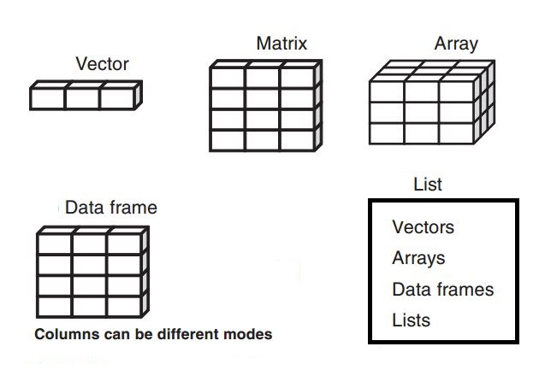
Data structures in R
Vectors
Matrices
Arrays
Data frames
Factors
Lists
Kabacoff, R. (2011). R in action: Data analysis and graphics with R.

Slide 3
Vectors
One-dimensional
Numeric data, character data, or logical data
c() is used to form the vector, it is called the combine function
a <- c(1, 2, 5, 3, 6, -2, 4)
b <- c("one", "two", "three")
c <- c(TRUE, TRUE, TRUE, FALSE, TRUE, FALSE)
Kabacoff, R. (2011). R in action: Data analysis and graphics with R.

Slide 4
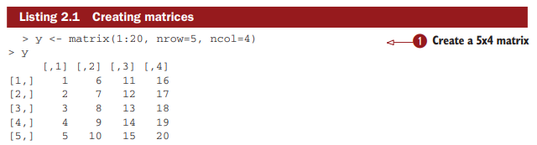
Matrices
Two-dimensional
Each element - same values (numeric, character, or logical)
Create with matrix function
Kabacoff, R. (2011). R in action: Data analysis and graphics with R.

Slide 5
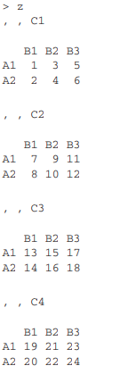
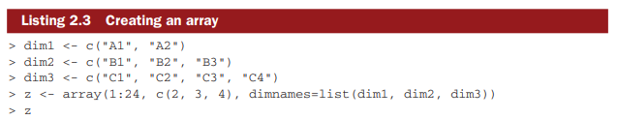
Arrays
Similar to matrices – can have more than 2 dimensions
Arrays = natural extension of matrices
Create with array function
Kabacoff, R. (2011). R in action: Data analysis and graphics with R.

Slide 6
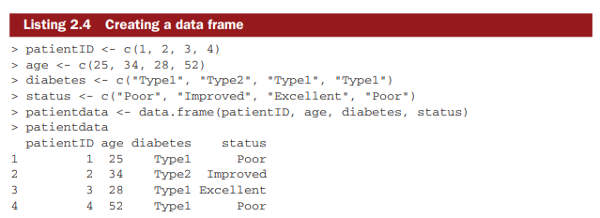
Data frames
The most common
Different columns have different data (numeric, character)
Create with data.frame() function
Kabacoff, R. (2011). R in action: Data analysis and graphics with R.

Slide 7
Factors
A variable can be nominal, ordinal, or continuous.
Nominal: Diabetes (Type 1 or Type 2) – no order
Ordinal: Customer level of satisfaction (Satisfied, Neutral, Dissatisfied)
Continuous: Age (e.g. 18 years old) any value within range, both order and amount
> diabetes <- c("Type1", "Type2", "Type1", "Type1") # this is a vector
> diabetes <- factor(diabetes) #stores this vector as (1, 2, 1, 1) where 1=Type1 and 2=Type2
Kabacoff, R. (2011). R in action: Data analysis and graphics with R.

Slide 8
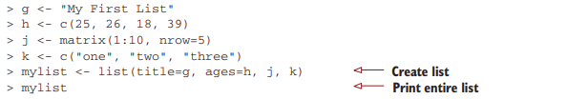
Lists
Most complex type
‘’An ordered collection of objects’’
Can contain a combination of vectors, matrices, data frames, and even other lists.
Create using the list() function
Kabacoff, R. (2011). R in action: Data analysis and graphics with R.

Slide 9
References
R in Action: Data Analysis and Graphics with R. Robert I. Kabacoff https://www.manning.com/books/r-in-action
http://www.ahschulz.de/pub/R/data_structures/Data_Structures_in_R_web.pdf
https://swcarpentry.github.io/r-novice-inflammation/13-supp-data-structures/
https://www.geeksforgeeks.org/data-structures-in-r-programming/
https://compgenomr.github.io/book/data-structures.html

